Slide 1
Topic 4 chemical bonding & Structure
Wilt Gu

Slide 2
Chemical Bond
Is a strong electrostatic attraction between atoms or ions that results in a reduction in the potential energy of the system which hence makes it become more stable.
The formation of a chemical bond between atoms involves the interaction of the electrons in the valence shells of the atoms.

Slide 3
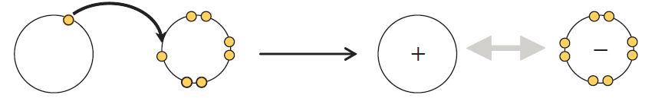
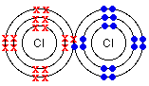
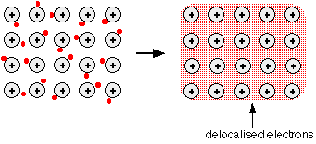
Chemical Bond
Three types: ionic, covalent, metallic.
Bond type depends on electronegativities of atoms involved.
Compound electronegativity Bond type
Na Cl L H Ionic
Cl Cl H H Covalent
Na Na L L Metallic

Slide 4
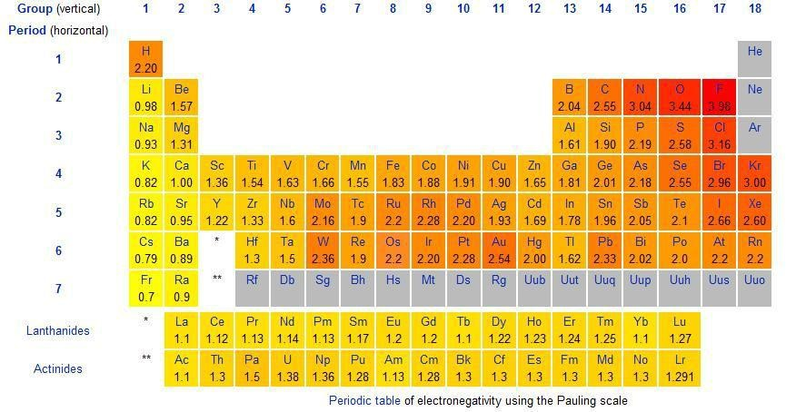
Electronegativity of Elements
Periodic table of electronegativity using the Pauling scale (0~4)

Slide 5
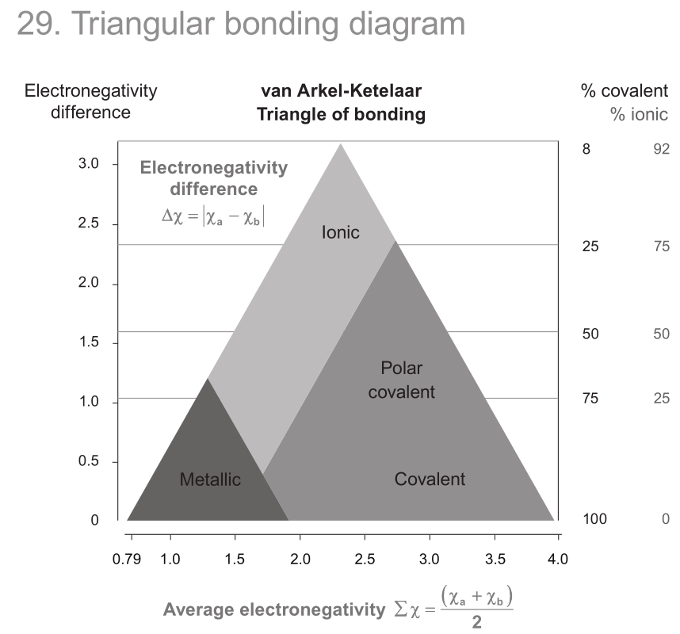

Slide 6
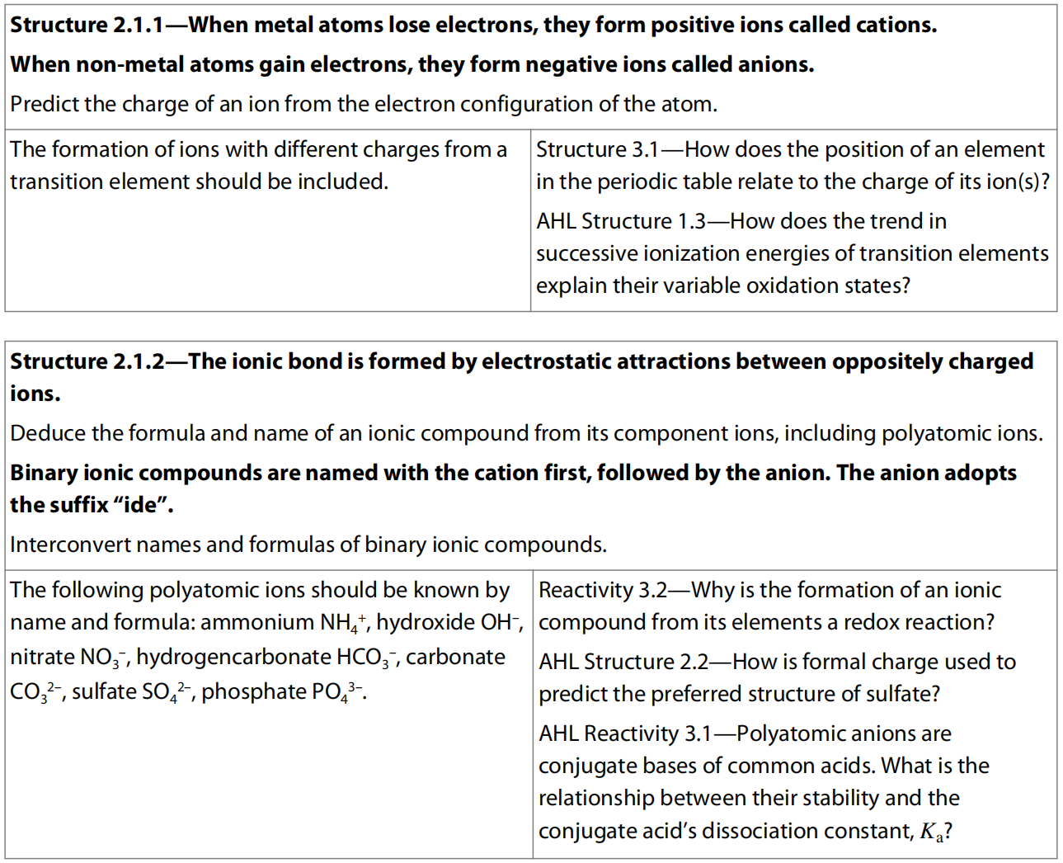
4.1 Ionic Bonding & Structures

Slide 7
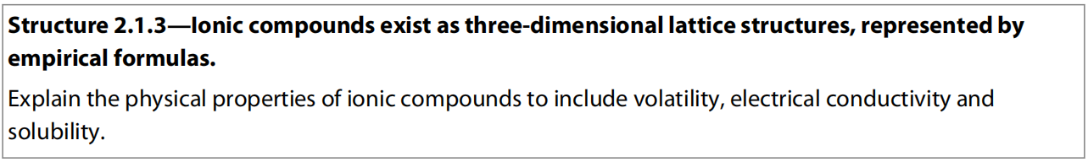
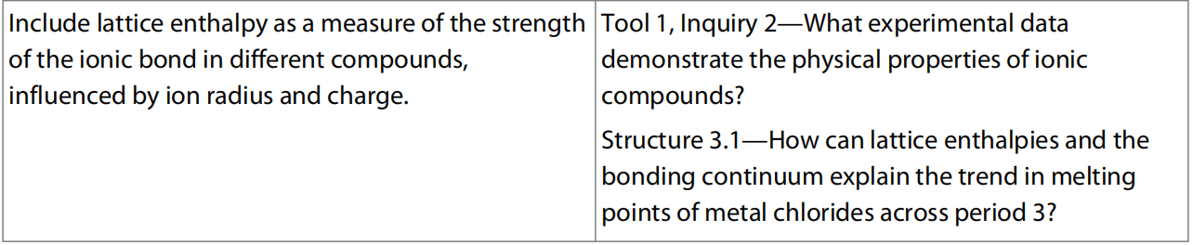

Slide 8
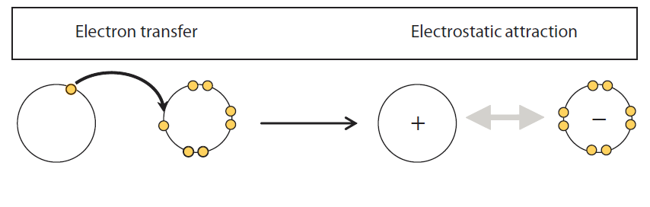
Orruring situation
Occurs between elements that have a large difference in electronegativity
Low electronegativity
High electronegativity
Cation
Anion
This is ionic bond

Slide 9
Ion Formation
Metal elements in group 1, 2, 3 lose all of the valence electron . e.g. Na⁺, Ca²⁺
Non-metal elements in group 6, 7 gain electrons to fill the valence shell. e.g. Cl⁻, O²⁻
Transition metals usually form stable ions with different charges (mostly with 2+) but with charges no more than 3+. e.g. Fe²⁺, Fe³⁺
Polyatomic ions are atoms that combine with covalent bonds and have overall charges. E.g. SO₄²⁻, PO₄³⁻, NO₃⁻, HCO₃⁻, CO₃²⁻, etc.

Slide 10
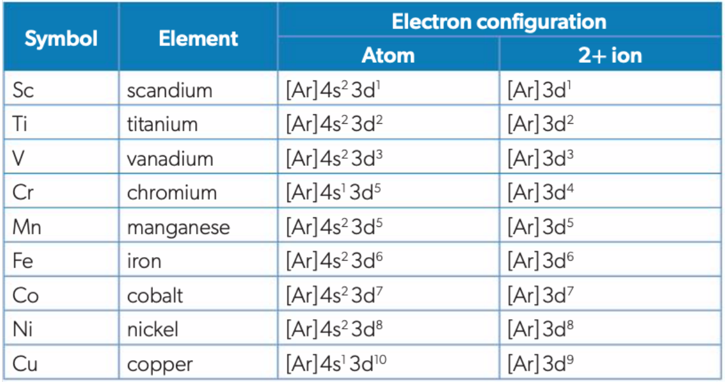

Slide 11
Ionic Bonding
Strong electrostatic attraction between cations and anions (oppositely charged ions).
Number of cations and anions depending on the charge to have the substance neutral.
IUPAC Naming covered before.

Slide 12
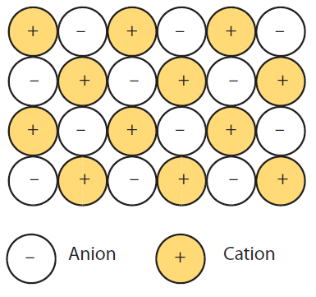
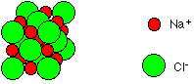
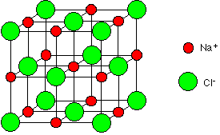
Crystal lattice

Slide 13
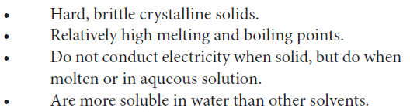
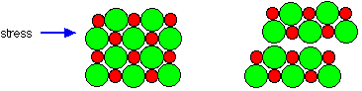
Physical Properties of ionic compounds
Brittleness

Slide 14
Comparing ionic bond strength between ionic compounds
NaF Vs Na₂O
The higher the charges on the ions, the stronger the ionic bond, then the higher the m.p. and the hardiness. (major factor)
NaF Vs NaCl
The bigger the size of the ions, the weaker the ionic bond, then the lower the m.p. and the hardiness.

Slide 15
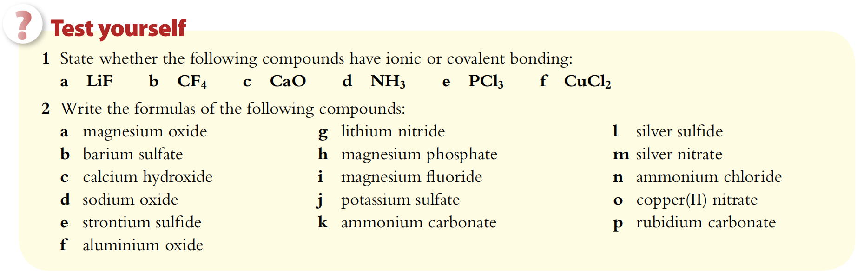

Slide 16
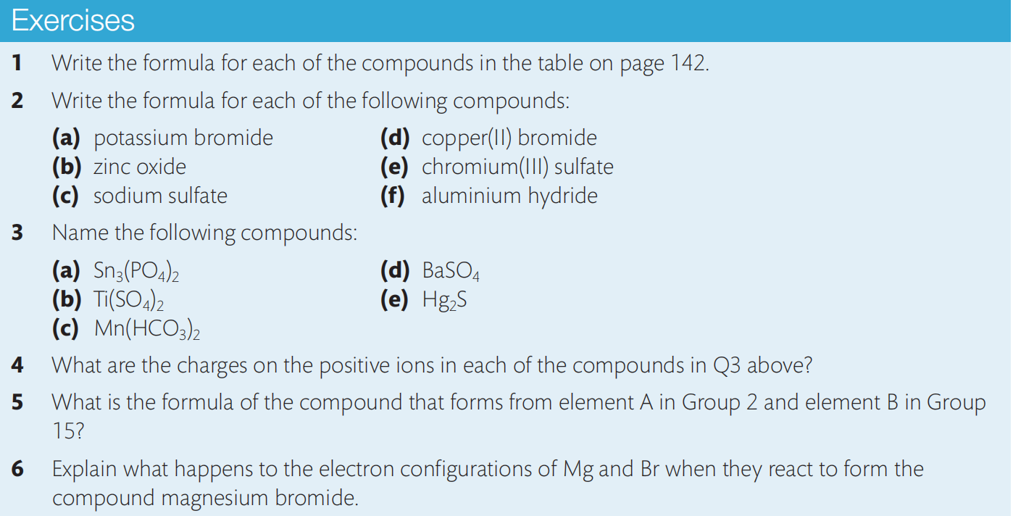
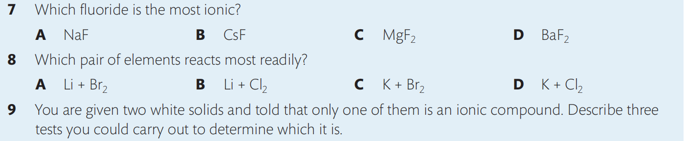

Slide 17
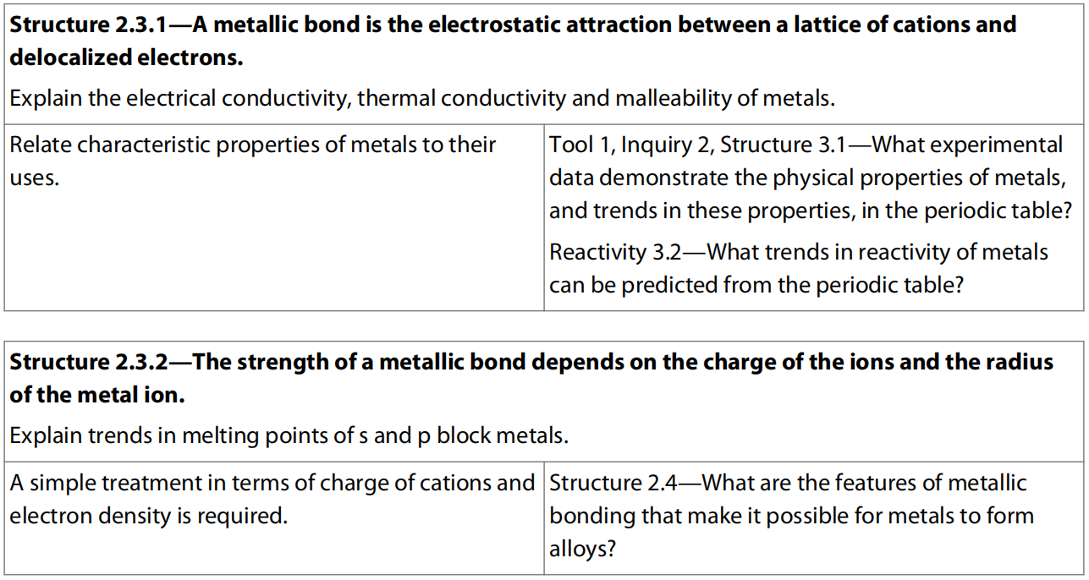
4.2 Metallic Bonding & Structures

Slide 18
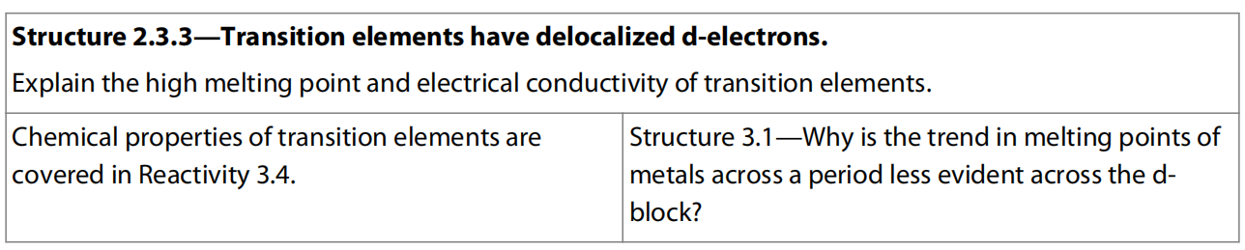
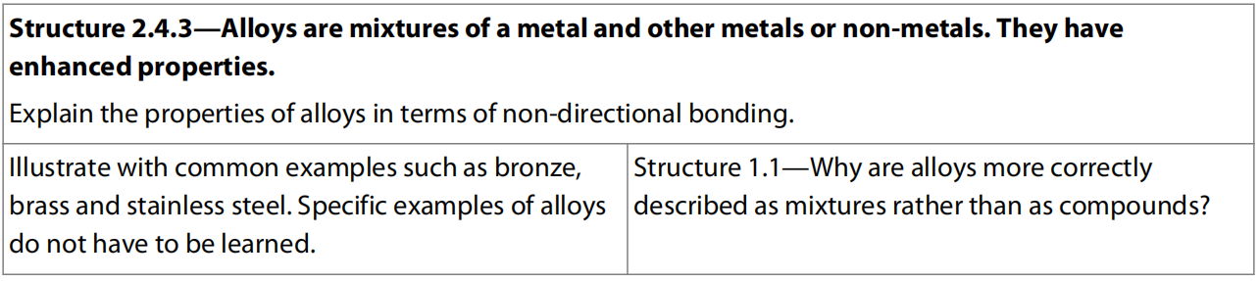
HL only

Slide 19
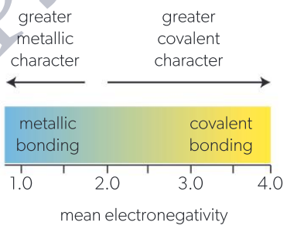
Metallic–covalent bonding continuum
On the left, there are elements with low electronegativity values that tend to form metallic bonds.
On the right, there are highly electronegative non-metals that form covalent bonds.
Metalloids are somewhere in the middle: they have both metallic and non-metallic properties.

Slide 20
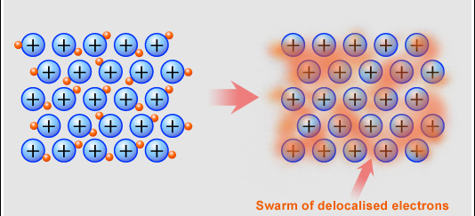
Metallic bonding
Occurs between atoms which all have low electronegativities.
Strong electrostatic attraction between metal cations and delocalized electrons.
Metallic structure is often described as consisting of a lattice of positive ions filled by a mobile “sea” of valence electrons
Outermost electrons wander freely through metal. Metal consists of cations held together by negatively-charged electron "glue."

Slide 21
Malleability & ductility
The layers of cations in metal are hard to pull apart because of the electrons holding them together, hence metals are tough.
Malleability is the ability of a solid to be pressed or pounded into different shapes without breaking. This useful property is the reason why metallic objects have such a wide array of shapes, ranging from sewing needles to aeroplanes to zippers to anchors.
Metallic bonding is non-directional.
When a force is applied to a metallic structure, the layers of cations can slide past each other without breaking the electrostatic attraction to the surrounding delocalized electrons.
The cations can therefore be rearranged, allowing the metal to take on a new shape.
Aluminium foil, often used to wrap food, demonstratesthat the metal aluminium is readily malleable.
A related property, ductility, is the ability of a solid to be stretched into wires.

Slide 22
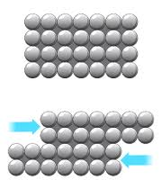
Unlike the brittleness in ionic compound

Slide 23
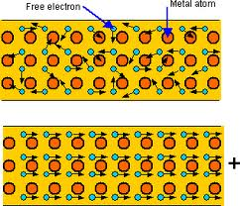
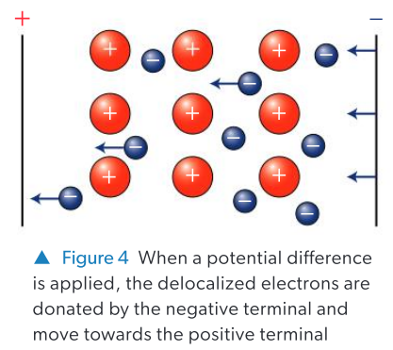
Electrical conductivity
Substances can conduct electricity when mobile charged particles are present.
Metal solid contains a lattice of cations surrounded by free-moving, negatively charged electrons.
The delocalized electrons move randomly throughout the metallic structure.
When a potential difference is applied, there is a net movement of electrons away from the negative terminal and towards the positive terminal.
-

Slide 24
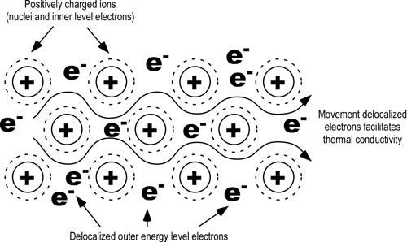
Heat conductivity
Metals conduct heat well.
The thermal energy of a substance is related to the kinetic energy of its particles.
When a substance is heated, its particles gain kinetic energy, so their vibrations and movement become more vigorous.
When a metal is heated, the vibrations of its cations increase in magnitude.
These vibrations are easily passed along to other cations because of their closely packed arrangement. The vibrating cations also transfer energy to the surrounding electrons through collisions. Since the electrons in metals are mobile, they can pass this increased kinetic energy to other parts of the lattice quickly.

Slide 25
Superconductivity
As thermal energy in metals increases, ions in the lattice vibrate more, so there are more collisions between electrons and ions.
Some kinetic energy is converted to heat with each collision.
These collisions are the cause of electrical resistance in metals, which increases with temperature.
Conversely, a decrease in temperature reduces the frequency of collisions, so the electrons move in a more direct path, and so the electrical resistance decreases.
Superconductors are materials that offer no resistance to electric current below a critical temperature.
At very low temperatures many metals and some other materials exhibit this property.

Slide 26
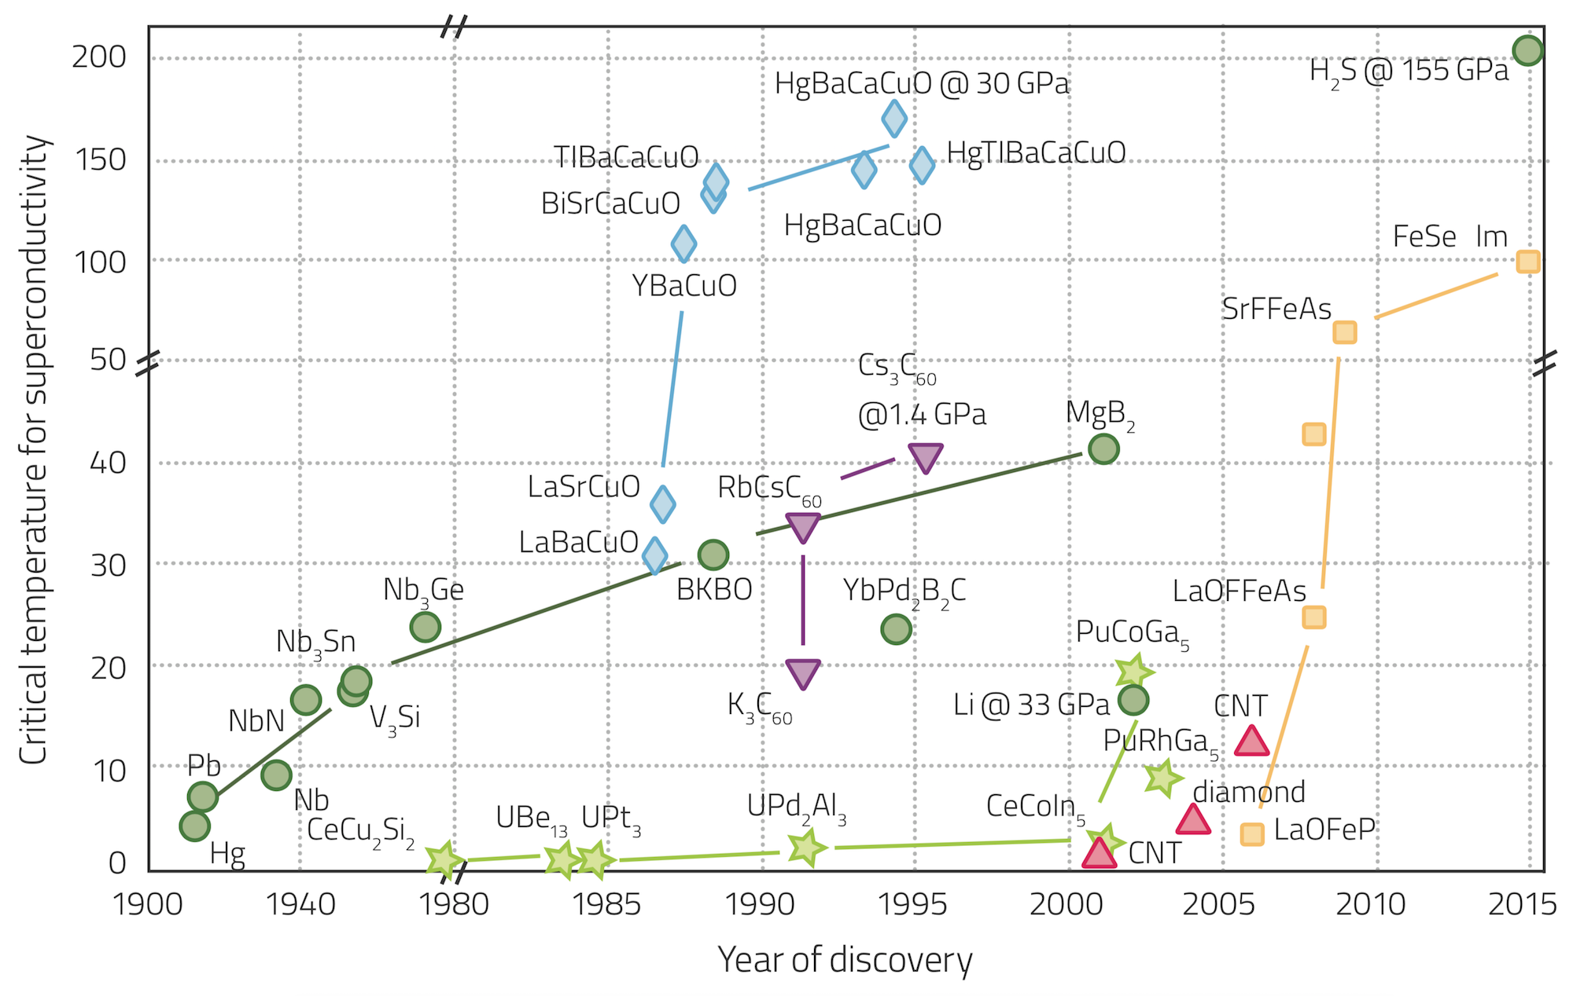
/K

Slide 27
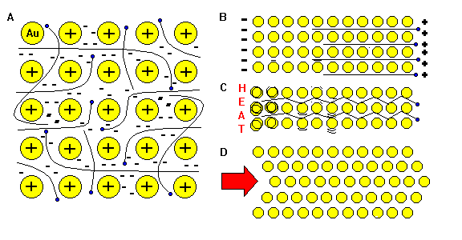
Properties of metal
Metals are typically:
• good electrical conductors because they contain mobile delocalized electrons;
• good thermal conductors because they contain mobile delocalized electrons and closely packed cations;
• malleable and ductile, because the layers of cations can slide past each other without breaking the metallic bonds.

Slide 28
Strength of metallic bonding
Ionic charge (how many electrons each atom provides as delocalized electrons): The higher the ionic charge, the stronger the metallic bond, so the higher the m.p.
K 2,8,8,1 m.p. 337K
Ca 2,8,8,2 1123K
Sc 2,8,9,2 1703K
Ionic radius (how far between the positive nucleus and the delocalized electrons in the “sea” are): The larger ionic radius the weaker the metallic bond, so the lower the m.p.
Li 2,1 m.p. 454K
Na 2,8,1 371K
K 2,8,8,1 337K

Slide 29
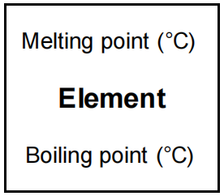
Metallic bonding in transition metals (HL)
Transition metal atoms mostly provide more than 2 electrons as delocalized electrons to form stronger metallic bond.
All or part of their d electrons get involved (depend on the stabilities of the ions and other factors).
Most transition metals have higher m.p. & b.p., are harder and better electrical conductors than alkali and alkaline earth metals.
No clear trend in m.p. of transition metals across the period 4.

Slide 30
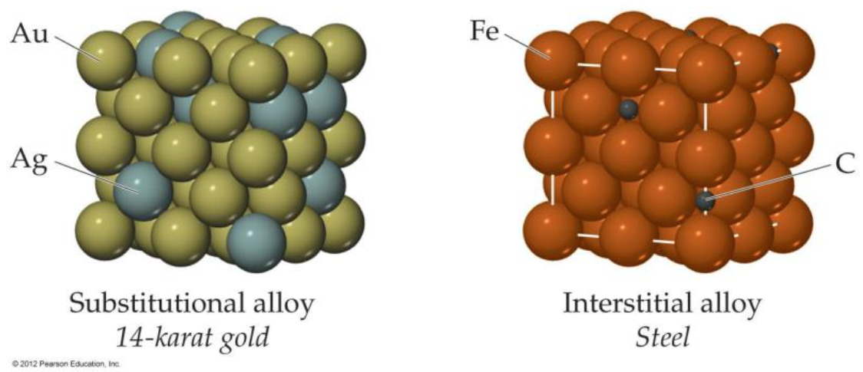
Alloys
Alloys are produced by adding one metal element to another metal (or carbon) in the molten state, so that the different atoms can mix to form a solution.
As the mixture solidifies, ions of the different metals are scattered through the lattice and bound by the delocalized electrons, so they contain metallic bonds.
The production of alloys is possible because of the non-directional nature of the delocalized electrons, and the fact that the lattice can accommodate ions of different sizes.

Slide 31
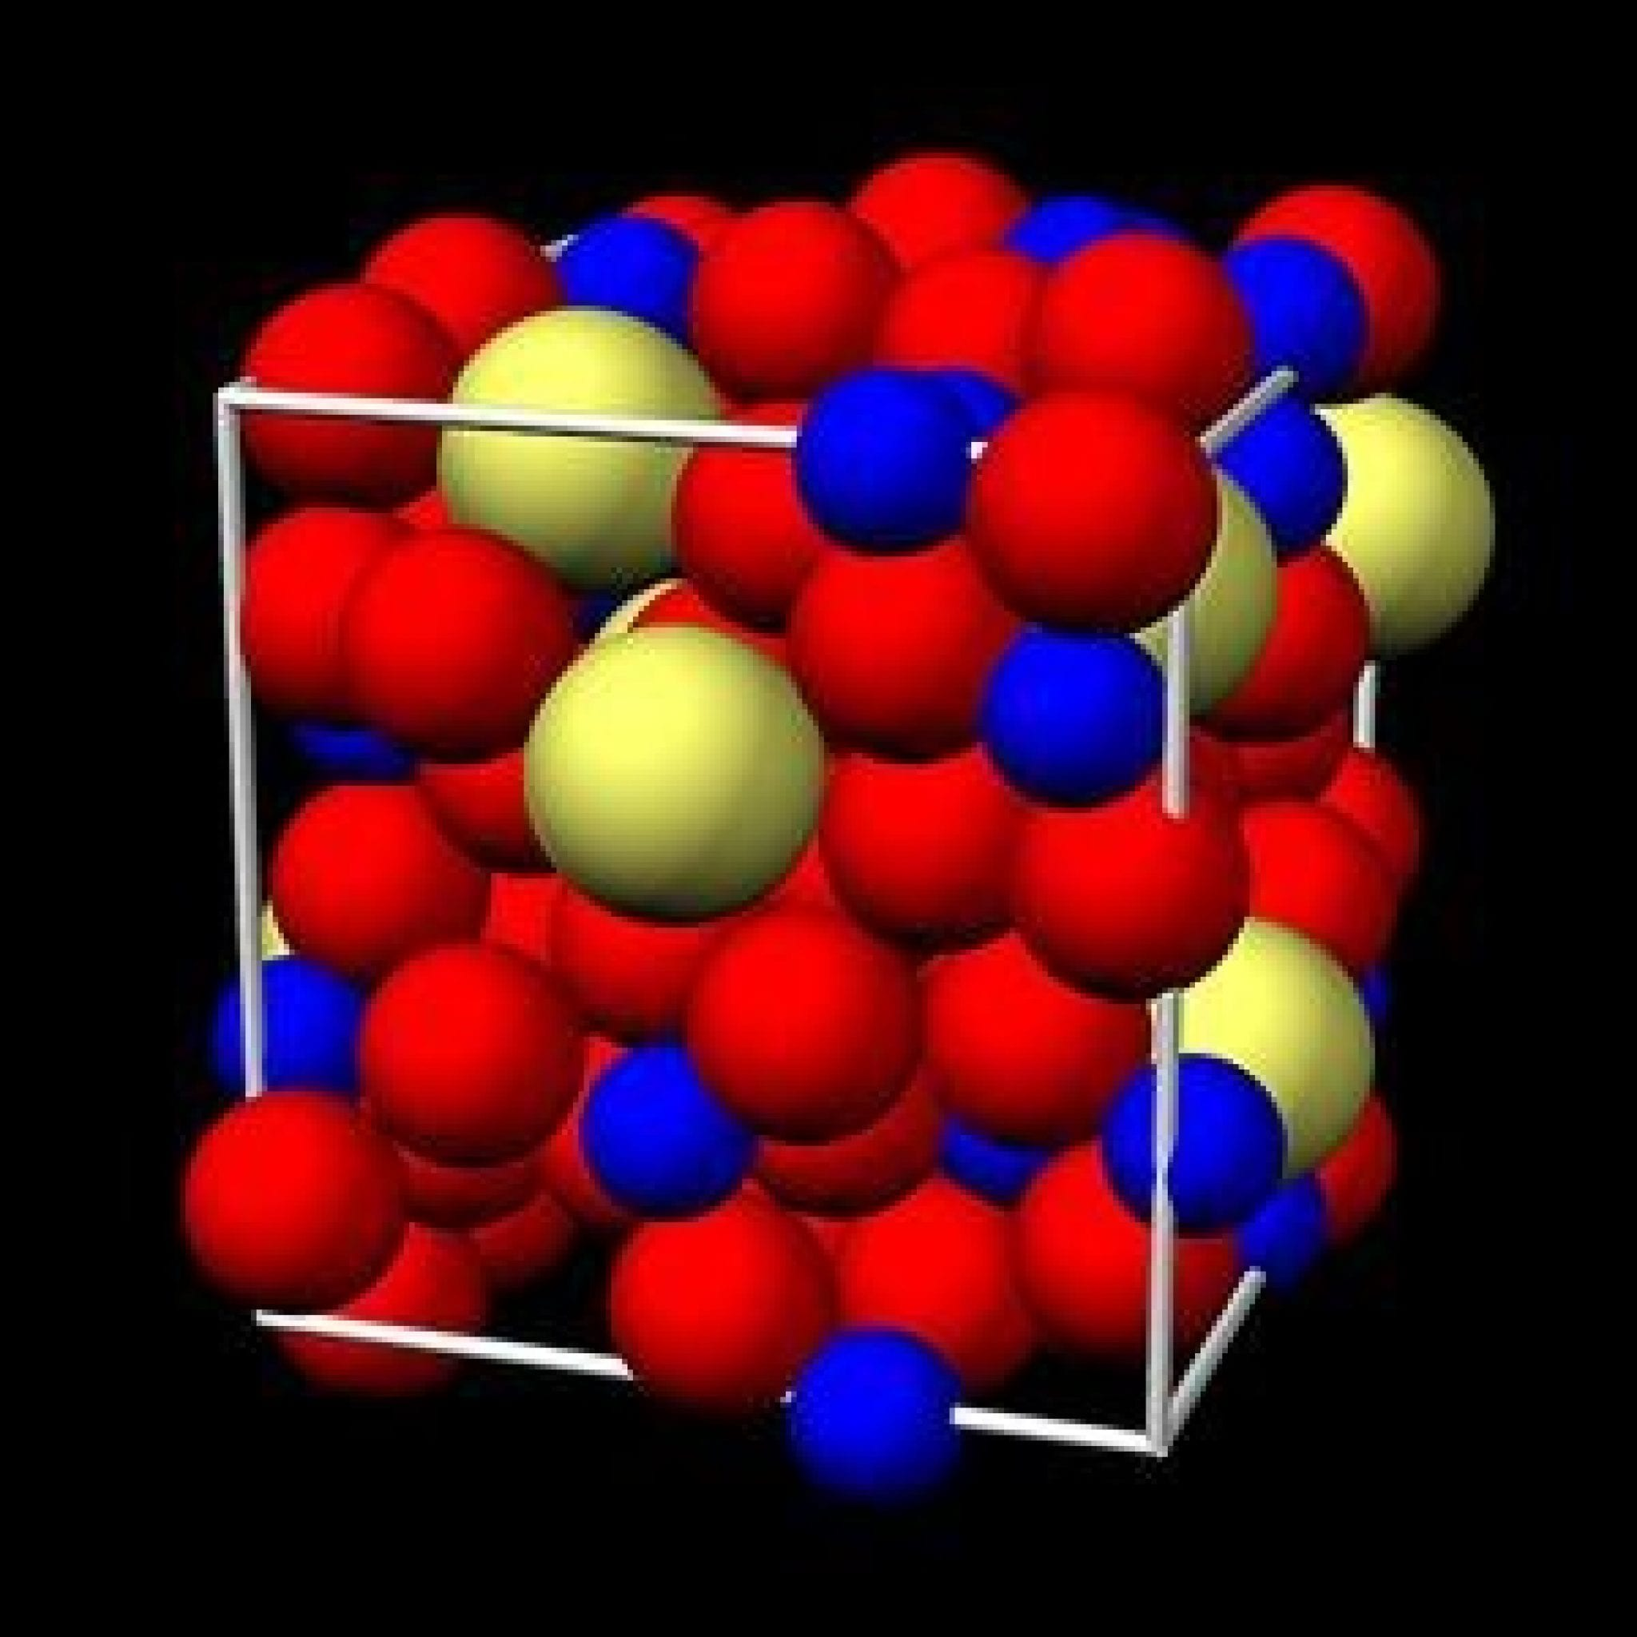
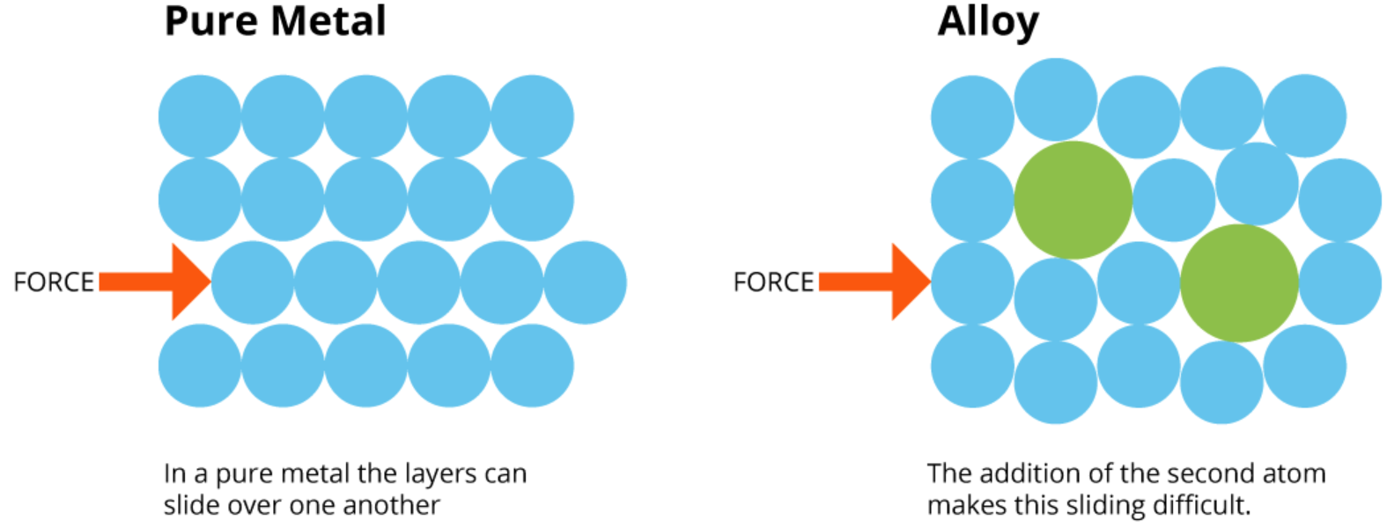
Alloys
Alloys have properties that are distinct from their component elements due to the different packing of the cations in the lattice.
The alloy is often more chemically stable (more resistant to corrosion), and also often harder, less malleable (so stronger), and lower melting point.

Slide 32
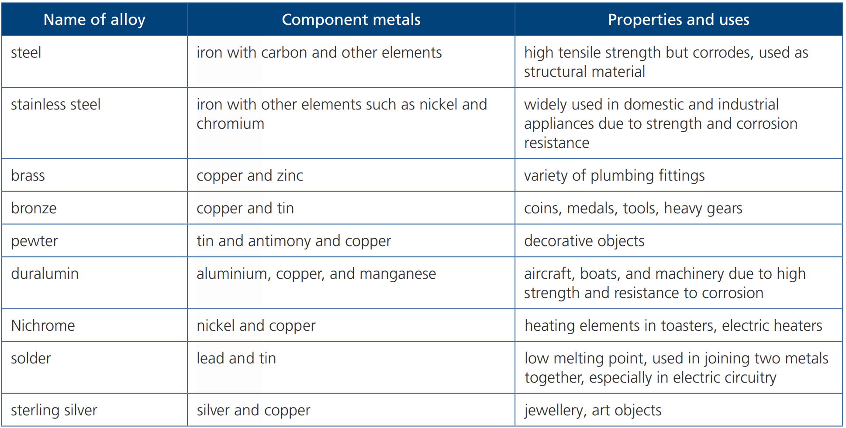
Commonly used alloys (not required)

Slide 33
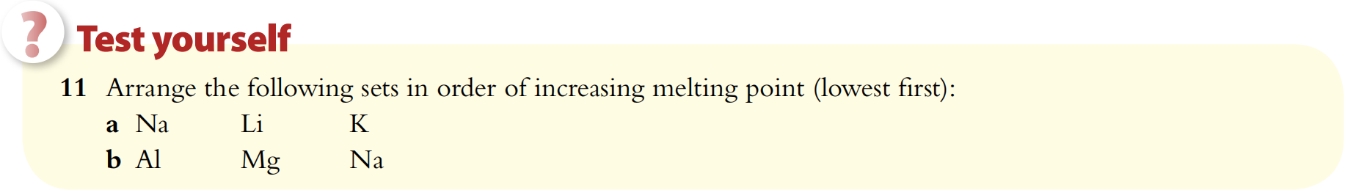
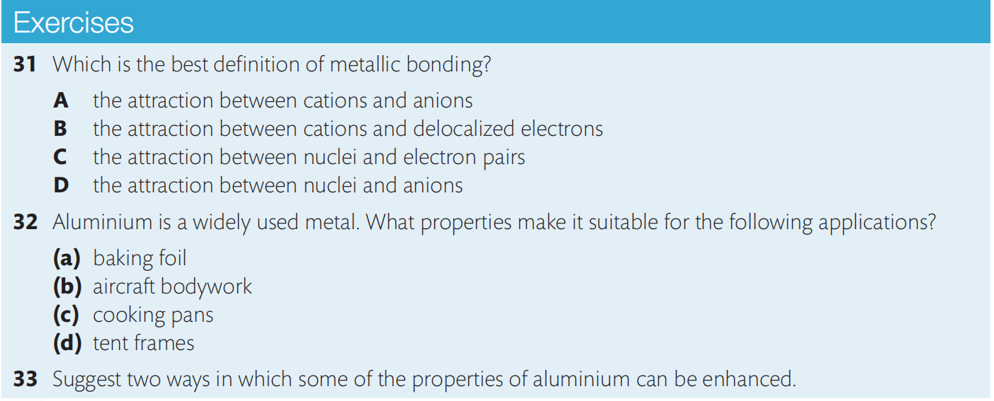

Slide 34
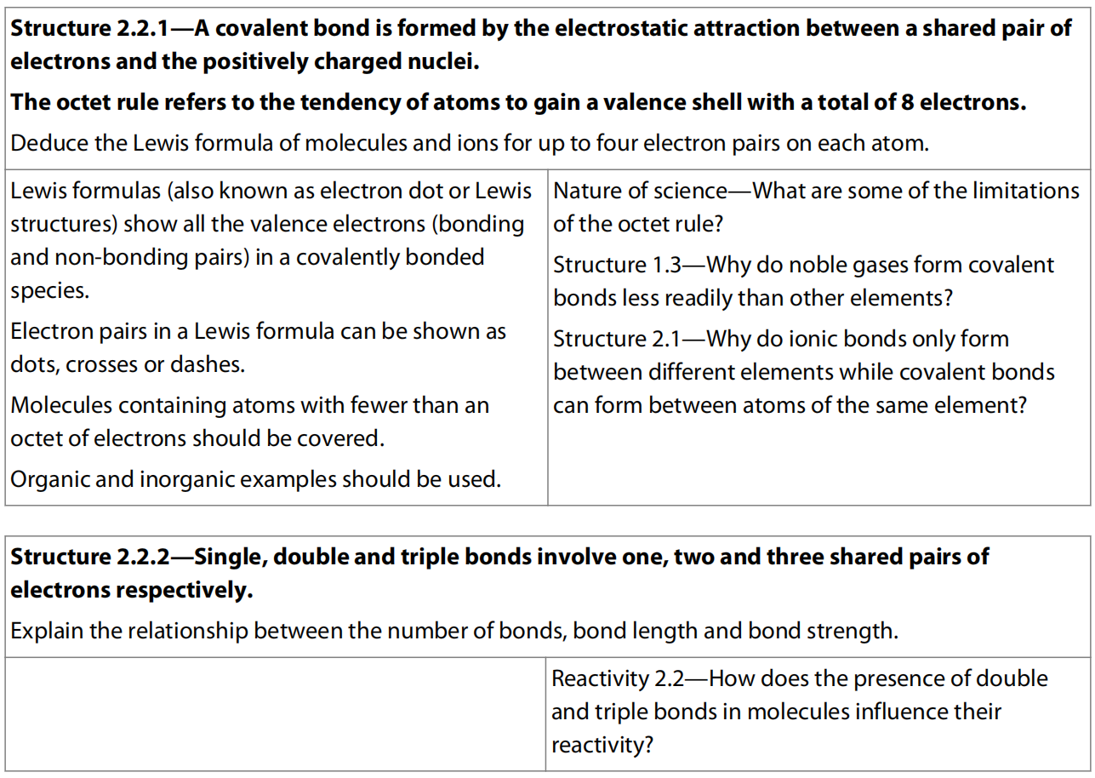
4.3 Covalent Bonding

Slide 35
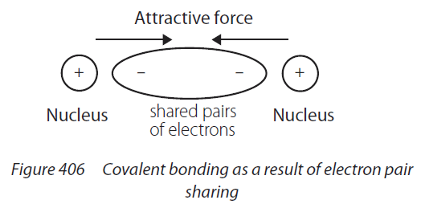
Covalent bonding
Covalent bonding occurs between atoms that have relatively high electronegativities, so mostly between nonmetals.
Strong electrostatic attraction between shared pairs of electrons and nuclei of the atoms involved.

Slide 36
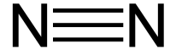
Bond Order
# of electron Pair shared Example Bond Order
Single covalent bond one pair H-H 1
Double covalent bond two pair O=O 2
Triple covalent bond three pair 3

Slide 37
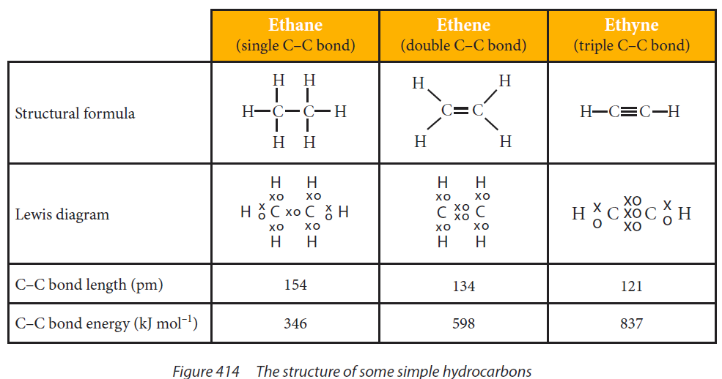
Bond length and strength

Slide 38
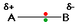
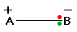
Electronegativity Vs Bond type
No electronegativity difference between two atoms leads to a pure non-polar covalent bond.
A small electronegativity difference leads to a polar covalent bond.
A large electronegativity difference leads to an ionic bond.

Slide 39
Electronegativity of Elements
Periodic table of electronegativity using the Pauling scale (0~4)

Slide 40
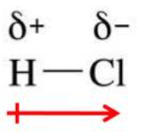
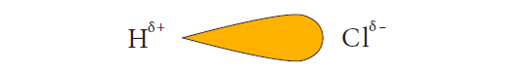
Polar bond
V.S.

Slide 41
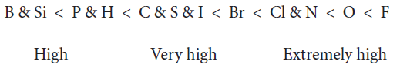
Polarity in covalent bonding
Who is more polar in these bonds?
H-Cl
H-F
H-I

Slide 42
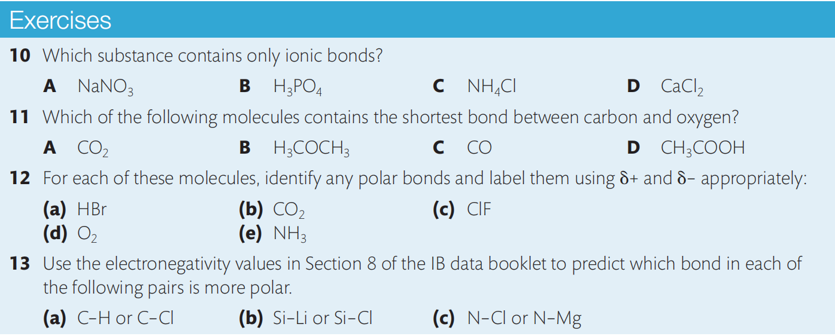

Slide 43
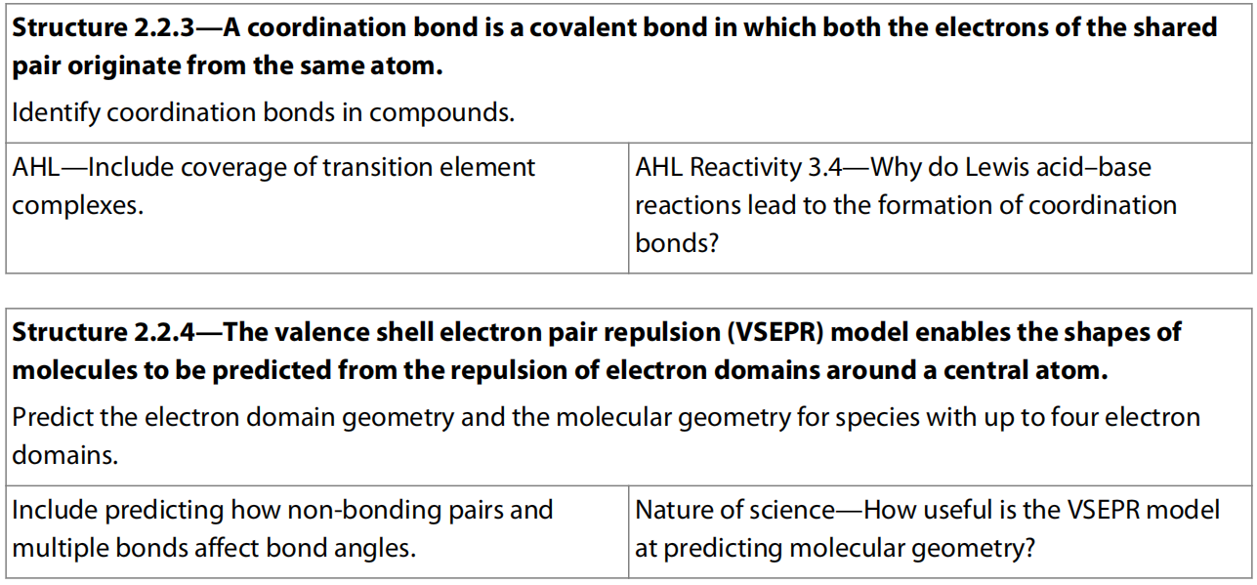
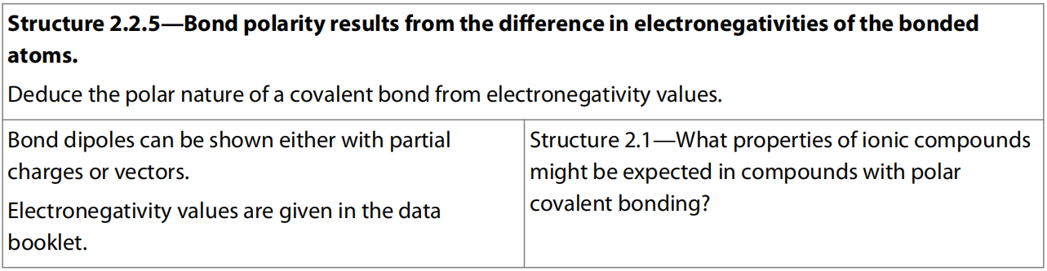
4.4 Covalent Structures

Slide 44
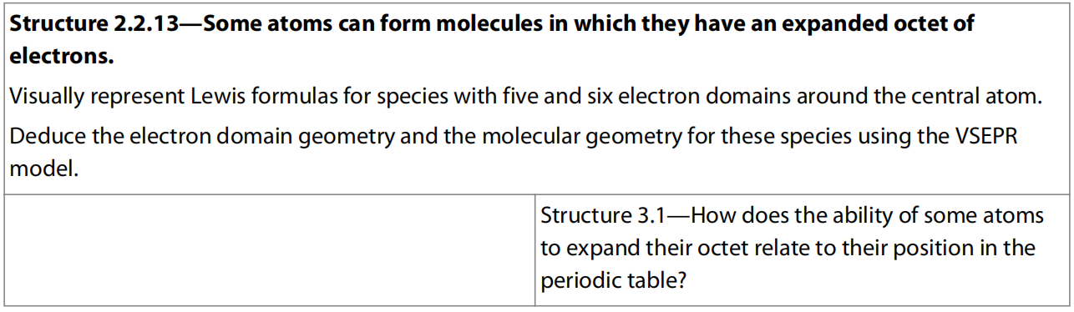
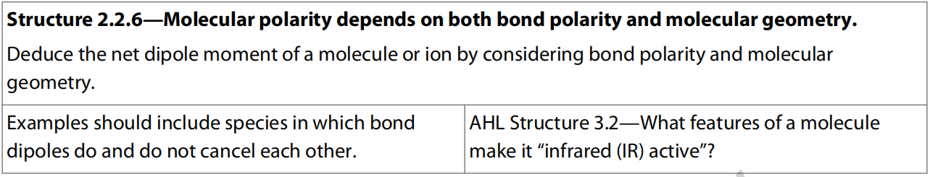
HL ONLY

Slide 45

Octet rule
Most atoms tend to combine in such a way that they each have eight electron in their valence shells (except H), giving them the same electronic arrangement as a noble gas.

Slide 46


Lewis structure/Lewis dot diagram
Who is Lewis structure, who is not?

Slide 47


Lewis structure/Lewis dot diagram
· · · ·
·
·
·
·
· · · ·

Slide 48

Dative bond/coordinate bond

Slide 49
Strategy to draw Lewis structure
Key steps:
1. Know the # of valence electron for each atom-----how many bond does each need.
2. Arrange the atoms by putting the atom with lowest electronegativity (except H) in the center, and the rest in the surrounding (for oxyacids, make H bond to O then to the central atom.
3. Add electron on most electronegative atom (except H, halogens) for anion, remove electron from least electronegative atom for cation.
4. Link proper bonds from the surrounding atoms to the central atoms one by one to fulfill their octet (for central atoms, exceptions could occur).
5. Add lone pair electrons where needed.
6. Use “[ ]^{z±}” for the ions (z is the charge).
Practice:
Draw Lewis diagram for:
H₂O, NH₃ , CH₄ , C₂H₆ , C₂H₄ , C₂H₂ , OH⁻ , HCN , HCO₂⁻ , O₂ , N₂, CO, O₃

Slide 50
VSEPR Theory
Valence shell electron pair repulsion theory is a model in chemistry used to predict the shape of individual molecules based upon the extent of electron-pair electrostatic repulsion.
The shape of a molecule is determined by repulsion between the electron pairs in the valence shell, or to say between the regions of high electron density in the valence level: covalent bonds and non-bonding/lone electron pairs.
Al
Al

Slide 51
VALENCE SHELL ELECTRON PAIR REPULSION THEORY
“THE SHAPE ADOPTED BY A SIMPLE MOLECULE OR ION IS THAT WHICH KEEPS REPULSIVE FORCES TO A MINIMUM”
Bonds are closer together so repulsive forces are greater
Molecules contain covalent bonds. As covalent bonds consist of a pair of electrons, each bond will repel other bonds.
Al
Bonds are further apart so repulsive forces are less
Bonds will therefore push each other as far apart as possible to reduce the repulsive forces.
Because the repulsions are equal, the bonds will also be equally spaced
All bonds are equally spaced out as far apart as possible
Al

Slide 52
VALENCE SHELL ELECTRON PAIR REPULSION THEORY
“THE SHAPE ADOPTED BY A SIMPLE MOLECULE OR ION IS THAT WHICH KEEPS REPULSIVE FORCES TO A MINIMUM”
All bonds are equally spaced out as far apart as possible to give minimum repulsive forces
O
Because of the equal repulsive forces between bond pairs, most simple molecules, (ones with a central atom and others bonded to it), have standard shapes with equal bond angles.
However, the presence of lone pairs on the central atom affects the angle between the bonds and thus affects the shape.
MOLECULES WITHOUT LONE PAIRS
MOLECULES WITH LONE PAIRS

Slide 53
REGULAR SHAPES
Molecules, or ions, possessing ONLY BOND PAIRS of electrons fit into a set of standard shapes. All the bond pair-bond pair repulsions are equal.
All you need to do is to count up the number of bond pairs and chose one of the following examples...
C
A covalent bond will repel another covalent bond
ELECTRON BOND
DOMAIN SHAPE ANGLE(S) EXAMPLE
2 LINEAR 180º BeCl₂
3 TRIANGULAR PLANAR 120º AlCl₃
4 TETRAHEDRAL 109.5º CH₄
5 TRIGONAL BIPYRAMIDAL 90º & 120º & 180°PCl₅
6 OCTAHEDRAL 90º & 180° SF₆

Slide 54
BERYLLIUM CHLORIDE
Be
Cl
Cl
Be
Cl
Beryllium - has two electrons to pair up
Chlorine - needs 1 electron for ‘octet’
Two covalent bonds are formed
Beryllium still has an incomplete shell
BOND PAIRS 2
LONE PAIRS 0
180°
BOND ANGLE...
SHAPE...
Cl
Be
Cl
180°
LINEAR

Slide 55

ADDING ANOTHER ATOM - ANIMATION

Slide 56
ALUMINIUM CHLORIDE
Al
Cl
Cl
Cl
Al
Aluminium - has three electrons to pair up
Chlorine - needs 1 electron to complete ‘octet’
Three covalent bonds are formed; aluminium still has an incomplete outer shell.
Cl
BOND PAIRS 3
LONE PAIRS 0
Cl
120°
Cl
Al
BOND ANGLE...
SHAPE...
120°
TRIANGULAR PLANAR
Cl

Slide 57

ADDING ANOTHER ATOM - ANIMATION

Slide 58
METHANE
H
H
H
C
H
C
H
Carbon - has four electrons to pair up
Hydrogen - 1 electron to complete shell
Four covalent bonds are formed
C and H now have complete shells
BOND PAIRS 4
LONE PAIRS 0
H
109.5°
C
H
BOND ANGLE...
SHAPE...
109.5°
TETRAHEDRAL
H
H

Slide 59

METHANE
H
H
H
C
H
C
H
Carbon - has four electrons to pair up
Hydrogen - 1 electron to complete shell
Four covalent bonds are formed
C and H now have complete shells
BOND PAIRS 4
LONE PAIRS 0
BOND ANGLE...
SHAPE...
109.5°
TETRAHEDRAL

Slide 60
Molecules contain a central atom with an expanded octet
when the central atom is an element from the Period 3 or below, we sometimes find compounds in which there are more than eight electrons around the central atom. This is known as an expanded octet.
This arrangement is possible because the d orbitals available in the valence shell of these atoms have energy values relatively close to those of the p orbitals.
promotion of electrons, for example from 3p to empty 3d orbitals, will allow additional electron pairs to form.

Slide 61
PHOSPHORUS(V) FLUORIDE
F
P
F
F
F
P
Phosphorus - has five electrons to pair up
Fluorine - needs one electron to complete ‘octet’
Five covalent bonds are formed; phosphorus can make use of d orbitals to expand its ‘octet’
F
F
BOND PAIRS 5
LONE PAIRS 0
F
F
90°
120°
P
F
BOND ANGLE...
SHAPE...
120°& 90°& 180 °
TRIGONAL BIPYRAMIDAL
F
F

Slide 62
SULPHUR(VI) FLUORIDE
F
S
F
F
F
S
Sulphur - has six electrons to pair up
Fluorine - needs one electron to complete ‘octet’
Six covalent bonds are formed; sulphur can make use of d orbitals to expand its ‘octet’
F
F
F
BOND PAIRS 6
LONE PAIRS 0
F
90°
F
F
BOND ANGLE...
SHAPE...
S
90°& 180 °
OCTAHEDRAL
F
F
F

Slide 63

SULPHUR(VI) FLUORIDE
F
S
F
F
F
S
Sulphur - has six electrons to pair up
Fluorine - needs one electron to complete ‘octet’
Six covalent bonds are formed; sulphur can make use of d orbitals to expand its ‘octet’
F
F
F
BOND PAIRS 6
LONE PAIRS 0
BOND ANGLE...
SHAPE...
90°& 180 °
OCTAHEDRAL

Slide 64

IRREGULAR SHAPES
If a molecule, or ion, has lone pairs on the central atom, the shapes are slightly distorted away from the regular shapes. This is because of the extra repulsion caused by the lone pairs.
BOND PAIR - BOND PAIR < LONE PAIR - BOND PAIR < LONE PAIR - LONE PAIR
O
O
O
As a result of the extra repulsion, bond angles tend to be slightly less as the bonds are squeezed together.

Slide 65
AMMONIA
H
BOND PAIRS 3
LONE PAIRS 1
TOTAL PAIRS 4
N
H
H
N
H
The shape is based on a tetrahedron but not all the repulsions are the same
LP-BP REPULSIONS > BP-BP REPULSIONS
The N-H bonds are pushed closer together
Lone pairs are not included in the shape
N
H
107°
N
H
H
N
H
H
H
ANGLE... 107°
SHAPE... TRIGONAL PYRAMIDAL
H
H
H

Slide 66


AMMONIA
H
BOND PAIRS 3
LONE PAIRS 1
TOTAL PAIRS 4
N
H
H
N
H

Slide 67
WATER
H
BOND PAIRS 2
LONE PAIRS 2
TOTAL PAIRS 4
O
H
H
O
The shape is based on a tetrahedron but not all the repulsions are the same
LP-LP REPULSIONS > LP-BP REPULSIONS > BP-BP REPULSIONS
The O-H bonds are pushed even closer together
Lone pairs are not included in the shape
O
104.5°
O
H
H
O
H
ANGLE... 104.5°
SHAPE... Bent or ‘V’ shaped
H
H
H

Slide 68
One non-bonding pair gives an asymmetrical tetrahedral or see-saw shape.
There will be some distortion of the shape due to the greater repulsion of the nonbonding pair of electrons, so bond angles will be 88°, 117°, and 176°.

Slide 69
Two non-bonding pairs gives a T-shaped structure.
The bond angles are 88° and 176°.

Slide 70
Three non-bonding pairs gives a linear shape. For example I₃⁻
The bond angle is 180°.

Slide 71
One non-bonding pair gives a square pyramidal shape.
The bond angle is 88°, 176°.

Slide 72
Two non-bonding pairs will maximize their distance apart by arranging those pairs at 180°to each other. This gives a square planar shape.
The bond angle is 90°&180°.

Slide 73


XENON TETRAFLUORIDE
F
F
BOND PAIRS 4
LONE PAIRS 2
TOTAL PAIRS 6
Xe
F
Xe
F
F
As the total number of electron pairs is 6, the shape is BASED on an octahedron
There are two possible spatial arrangements for the lone pairs
The preferred shape has the two lone pairs opposite each other
F
F
F
Xe
F
F
Xe
F
F
F
ANGLE... 90°
SHAPE... SQUARE PLANAR

Slide 74
CALCULATING THE SHAPE OF IONS
The shape of a complex ion is calculated in the same way a molecule by...
calculating the number of electrons in the outer shell of the central species *
pairing up electrons, making sure the outer shell maximum is not exceeded
calculating the number of bond pairs and lone pairs
using ELECTRON PAIR REPULSION THEORY to calculate shape and bond angle(s)
the number of electrons in the outer shell depends on the charge on the ion
if the ion is positive you remove as many electrons as there are positive charges
if the ion is negative you add as many electrons as there are negative charges
e..g. for PF₆⁻ add one electron to the outer shell of P
for PCl₄⁺ remove one electron from the outer shell of P

Slide 75
EXAMPLE
SHAPES OF IONS
Draw outer shell electrons of central atom
For every positive charge on the ion, remove an electron from the outer shell
For every negative charge add an electron to the outer shell..
for NH₄⁺ remove 1 electron
for NH₂⁻ add 1 electron
Pair up electrons in the usual way
Work out shape and bond angle(s) from number of bond pairs and lone pairs.
N
NH₄⁺
NH₂⁻
N⁺
N
H
H
H
N⁺
H
H
N
H
BOND PAIRS 4
LONE PAIRS 0
TETRADHEDRAL
H-N-H 109.5°
BOND PAIRS 2
LONE PAIRS 2
‘V’ SHAPED
H-N-H 104.5°

Slide 76
REVIEW
SHAPES OF IONS
H
NH₃
N
BOND PAIRS 3 PYRAMIDAL
LONE PAIRS 1 H-N-H 107°
H
N
H
H
NH₄⁺
BOND PAIRS 4 TETRAHEDRAL
LONE PAIRS 0 H-N-H 109.5°
N⁺
H
N⁺
H
H
H
NH₂⁻
N
BOND PAIRS 2 ‘V’SHAPED
LONE PAIRS 2 H-N-H 104.5°
H
N

Slide 77
MOLECULES WITH MULTIPLE BONDS
The shape of a compound with a double/triple bond is calculated in the same way. A double bond repels other bonds as if it was single e.g. carbon dioxide
C
O
O
C
O
Carbon - needs four electrons to complete its shell
Oxygen - needs two electron to complete its shell
The atoms share two electrons
each to form two double bonds
DOUBLE BOND PAIRS 2
LONE PAIRS 0
180°
O
C
O
Double bonds behave exactly as single bonds for repulsion purposes so the shape will be the same as a molecule with two single bonds and no lone pairs.
BOND ANGLE...
SHAPE...
180°
LINEAR

Slide 78
OTHER EXAMPLES
SO₄²⁻
O
O
BOND PAIRS 4
LONE PAIRS 0
TETRAHEDRAL
ANGLE 109.5°
O
S
O⁻
S
O⁻
O⁻
O
O⁻
BrF₃
F
F
BOND PAIRS 3
LONE PAIRS 2
’T’ SHAPED
ANGLE <90°
F
Br
F
Br
F
F
BrF₅
F
BOND PAIRS 5
LONE PAIRS 1
SQUARE PYRAMIDAL
ANGLES <180° <90°
F
F
Br
Br
F
F
F
F
F
F
F

Slide 79
Practice:
Predict the shape and bond angle of HCN, CO₃²⁻, and HPO₃²⁻ (knowing H₃PO₃ is diprotic acid) draw the Lewis structure, and give the reason based on VSEPR theory.

Slide 80
TEST QUESTIONS
For each of the following ions/molecules, state the number of electron domains
state the number of lone pairs
state the bond angle(s)
state, or draw, the shape
BF₃
SiCl₄
PCl₄⁺
PCl₆⁻
SiCl₆²⁻
H₂S
ANSWERS ON NEXT PAGE

Slide 81
TEST QUESTIONS
ANSWER
For each of the following ions/molecules, state the number of bond pairs
state the number of lone pairs
state the bond angle(s)
state, or draw, the shape
BF₃
3 bp 0 lp 120º trigonal planar boron pairs up all 3 electrons in
its outer shell
4 bp 0 lp 109.5º tetrahedral silicon pairs up all 4 electrons in
its outer shell
4 bp 0 lp 109.5º tetrahedral as ion is +, remove an electron
in the outer shell then pair up
6 bp 0 lp 90º octahedral as the ion is - , add one electron to
the 5 in the outer shell then pair up
6 bp 0 lp 90º octahedral as the ion is 2-, add two electrons
to the outer shell then pair up
2 bp 2 lp 92º ‘V’ shaped sulphur pairs up 2 of its 6 electrons in its outer shell -
2 lone pairs are left
SiCl₄
PCl₄⁺
PCl₆⁻
SiCl₆²⁻
H₂S

Slide 82
Summary of shapes of molecules predicted from VSEPR theory
Bond Angle
180°
120°
<120°
109.5°
<109.5°
<109.5°

Slide 83
Bond Angle
90° 120° 180°
<90° <120° <180°
<90° <180°
180°

Slide 84
Bond Angle
90° 180°
<90° <180°
90° 180°

Slide 85

Polarity in molecules
Polarity Vector
Molecular Dipole
Polar molecule

Slide 86

Polarity in molecules
Symmetrical shape --- Two polar bonds cancel each other
No Molecular Dipole
Non-polar molecule

Slide 87


Polarity in molecules

Slide 88

Polarity in molecules

Slide 89

Polarity in molecules

Slide 90
Molecular geometry determines molecular polarity
If there are no lone pairs and all the atoms attached to the central atom are the same, the molecules are non-polar as there is no net dipole.

Slide 91
If the atoms attached to the central atom are not all the same, there may or may not be a net dipole depending on the symmetry.

Slide 92
The presence of lone pairs often, but not always, results in a polar molecule. It again depends on symmetry and whether dipoles cancel.

Slide 93




Slide 94



Slide 95


Slide 96



Slide 97

4.5 Advanced Covalent structure (Higher Level)

Slide 98



Slide 99
Resonance Structures
The Lewis structures that can be drawn are known as resonance structures, while it is recognized that neither of these is the correct structure.
The true structure is an intermediate form, known as the resonance hybrid.

Slide 100
Delocalized bonds
Electrons in multiple bonds can sometimes spread themselves between more than one bonding position.
Instead of being confined to one location they show a tendency to be shared between more than one bonding position, and are said to be delocalized.
Ozone as an example:

Slide 101
Bond order
Is a measure of the number of electrons involved in bonds between two atoms. Values for bond order are: single bonds = 1, double bonds = 2, triple bonds = 3.
Resonance hybrids have fractional values of bond order. The carbon-carbon bonds in benzene have a bond order of 1.5.

Slide 102
Experimental data reveal that ozone actually contains two equal oxygen–oxygen bonds, intermediate in length and strength between single and double bonds.
Bond Order | 1 | 2 | 1.5

Slide 103
Delocalized bond in benzene
Bond Order | 1 | 2 | 1.5

Slide 104
Other examples for resonance structures
Bond Order
1.33
1.5
1.5

Slide 106
Practice:
Calculate the total number of valence electrons and draw the resonance structures and resonance hybrids of HCO₃⁻ and CH₃COO⁻

Slide 107
Formal charge
It is sometimes possible to follow the rules for drawing Lewis (electron dot) structures, and come up with more than one possible structure that seems to be acceptable.
This happens especially with molecules that are able to form an expanded octet, where we can broaden our study of resonance structures.

Slide 108
Formal charge
A classic example is sulfur dioxide, SO₂, which in different sources is represented as: (i)
Or (ii) as a structure with an expanded octet on S
Which is more stable so more preferred?

Slide 109
Formal charge
A useful tool to use for determining which of these represents the most stable structure is the concept of formal charge.
This treats covalent bonds as if they were purely covalent with equal electron distribution.
The idea is to count how many electrons ‘belong’ to (are assigned to) each atom in the Lewis (electron dot) structure, and compare this with the number of valence electrons in the non-bonded atom. The difference between these two is the formal charge.

Slide 110
Formal charge

Slide 111
Formal charge
Low formal charges mean that less charge transfer has taken place in forming a structure from its atoms, and in general this represents the most stable or preferred structure.

Slide 112
Formal charge

Slide 113
Formal charge
Formal charge is a useful tool but, because it ignores differences in electronegativity values, it does not give the full picture. So, a useful guideline to follow is that the most stable of several Lewis (electron dot) structures is the structure that has:
the lowest formal charges
negative values for formal charge on the more electronegative atoms.

Slide 114
Formal charge
The formal charges in each resonance structure can be summarized as follows:
We can conclude that structure (ii) where all atoms have a formal charge of zero is the most stable structure for SO₂.

Slide 115
Formal charge
For example, two Lewis (electron dot) structures with formal charges are shown for N₂O.
We can see that both structures have the same difference for formal charge, which suggests equal stability. But (i) has the negative charge over the more electronegative atom, O, and so it is preferred.
Formal charge can help explain the allocation of charges on transition states in reaction mechanisms.

Slide 116
Exercise for drawing Lewis structures considering formal charge
XeO₃, NO₃⁻, SO₄²⁻, N₂O, PCl₄⁺,NO₂, PO₄³⁻, SO₃

Slide 117
MnO₄⁻, CuCl₄²⁻

Slide 118
Limitation of formal charge
It is difficult to know the number of valence electrons a transition metal has.
Treating bonds from ligands as pure covalent molecules results in transition metals in complex ions with large negative formal charges.
The formal charge model may not be useful for complex ions, as the values obtained do not make much sense.
It is also hard to use formal charges to explain the stability of the molecules like NO₂, Benzene, etc.

Slide 119
Atomic orbitals overlap to form two types of covalent bond: σ and π
A bond as forming when two atomic orbitals, each containing one electron, overlap to form a new molecular orbital that is at a lower energy.
The shape of this molecular orbital can be predicted from the shapes of the two atomic orbitals, as described below.

Slide 120
The sigma (σ) bond
When two atomic orbitals overlap along the bond axis – an imaginary line between the two nuclei – the bond is described as a σ bond.
This type of bond forms by the overlap of s orbitals, p orbitals, and hybrid in different combinations. It is always the bond that forms in a single covalent bond.

Slide 122
The pi (π) bond
When two paralleled p orbitals overlap sideways, the electron density of the molecular orbital is concentrated in two regions, above and below the plane of the bond axis. This is known as a π bond.
This type of bond only forms by the overlap of p orbitals alongside the formation of a σ bond. In other words, π bonds only form within a double bond or a triple bond.

Slide 124
Examples for σ and π bonds
C₂H₆

Slide 125
Some conflicts
The directions of the σ bonds has great conflicts with the molecular shape predicted by VSEPR theory.
E.g.: directions of p orbitals are vertical with each other, then how the trigonal planar, tetrahedral, and other shapes are formed?
The bond enthalpy & length has great conflicts with facts.
E.g.: Since electrons in s orbital and p orbitals are different, why the bond enthalpy and bond length of the C-H bonds are exactly the same in CH₄?

Slide 126
Excitation of bonding electron(s)
In all of these, carbon forms four covalent bonds.
But considering the electron configuration in the carbon atom, it has only two singly occupied orbitals available for bonding.
Electron configuration of C: 1s² 2s² 2p_{x}¹ 2p_{y}¹
The fact that carbon forms four covalent bonds indicates that this lowest energy or ground-state electron configuration changes during bonding.
Excitation occurs in which an electron is promoted within the atom from the 2s orbital to the vacant 2p orbital. The atom now has four singly occupied orbitals available for bonding.

Slide 127


Slide 128
Hybridization
the atomic orbitals are not all the same: one s orbital, and three p orbitals with different energy. So if these were used in forming the covalent bonds, we would expect unequal bonds.
The fact that CH₄ has four identical carbon–hydrogen bonds suggests that these orbitals have been changed and somehow made equal during the bonding process.

Slide 129
Unequal atomic orbitals within an atom mix to form new hybrid atomic orbitals which are the same as each other in terms of energies and shapes, but different from the original orbitals. This mixing of orbitals is known as hybridization.
Hybrid orbitals have different energies, shapes, and orientation in space from their parent orbitals and are able to form stronger bonds by allowing for greater overlap.

Slide 130


methane, CH₄
109.5°
90°
less repulsion between the bonding pairs of electrons

Slide 131
Carbon has both 2s and 3, 2p orbitals
2s
2p
x
y
z
2s
2p_{x}
2p_{y}
2p_{z}

Slide 132

In alkanes these orbitals hybridise (mix) to make 4 sp³ orbitals
sp³
hybrid orbital angle 109.5°
2p_{x}
2p_{y}
2p_{z}
2s

Slide 133
Each bond in methane is formed by the overlap of an sp³ orbital and the ‘s’ orbital of hydrogen
C
H

Slide 134
Ethane
sp³
H
H
C
H
H

Slide 135
Ethane
sp³
H
H
H
C
●
●
C
H
H
H

Slide 136
Ethane
sp³
C_{sp3}-H_{s}
H
H
H
C
●
C
●
H
H
H
C_{sp3}-C_{sp3}

Slide 137

Ethane
sp³
C_{sp3}-H_{s}
C_{sp3}-C_{sp3}

Slide 138
Alternatively, hybridisation can take place between the ‘s’ and two of the ‘2p’ orbitals
sp²
hybrid orbital angle 120°
p_{z}
2p_{x}
2p_{y}
2p_{z}
2s

Slide 139
A model of ethene using hybrid and atomic orbitals.
·
H
·
H
C
·
C
π-bond from overlap of the p orbitals
H
H
·
σ-bond
from overlap of two sp² orbitals
H
H
C
C
H
H

Slide 140
Alternatively hybridisation can occur between the ‘s’ and one of the ‘2p’orbitals
sp
hybrid orbital angle 180°
p_{z}
sp
sp
p_{y}
2p_{x}
2p_{y}
2p_{z}
2s

Slide 141
c
c

Slide 142
c
c

Slide 143
c
c

Slide 144
In an alkyne the c-c bond consists of one sigma and two pi bonds
σ-bond
c
c
π-bond 2p_{y} and 2p_{y}
π-bond 2p_{z} and2p_{z}

Slide 145
Key points for hybrid orbitals
The higher proportion of s orbital in the hybrid orbitals, the lower average energy of the hybrid orbitals. E.g. sp<sp²<sp³ in energy if all formed from 2s and 2p of the same atom.
Hybrid orbitals are used to form sigma bonds or to hold lone pair electrons (except for the lone pair electrons also get involved in pi bond).
Hybrid orbitals are NOT used to form pi bonds or being a vacant orbital (have no electrons in), so unhybridized p orbitals are used instead.

Slide 146
Delocalized π bond
A big π bond in the whole or part of a molecules that the electrons involved are no longer strict in the range of the 2 atoms that form the multiple bond.

Slide 147
Benzene does not behave like other unsaturated molecules
The 1:1 ratio of carbon to hydrogen in benzene, C₆H₆, indicates a high degree of unsaturation, greater than that of alkenes or alkynes.
Yet early observations on benzene indicated that it does not show the characteristic properties of possible structures such as:

Slide 148
The symmetry of this model explained some of the known properties of benzene, such as the fact that it has no isomers, but again fell short of explaining benzene’s atypical reactivity for such an unsaturated molecule.
Clearly, modifications to the Kekulé structure were needed.
Advances in technology, such as X-ray diffraction, provided data that helped to develop the current model of benzene structure.

Slide 149
For example, benzene has no isomers, and is reluctant to undergo addition reactions – both features that would be expected from these molecules.
In 1865 German organic chemist Kekulé suggested a cyclic arrangement of the carbon atoms with alternating single and double bonds, which is cyclohexa-1,3,5-triene:

Slide 150


Slide 151
STRUCTURE OF BENZENE
Problems with Kekule’s structure:
1) C-C bonds are all the same length (between C-C and C=C length).
2) Benzene does not undergo addition reactions readily (e.g. with bromine water).
3) Do not get isomers like this:
4) ΔH hydrogenation about 152 kJ mol⁻¹ less than expected.

Slide 152
This model is supported by evidence, and provides explanations for most observed properties of benzene, as described below.

Slide 155
The special stability of the benzene ring is the result of delocalized electrons
Benzene is a cyclic structure, in which a framework of single bonds attaches each carbon to the one on either side and to a hydrogen atom.
Each of the six carbon atoms is sp² hybridized, and forms three sigma σ bonds with angles of 120°, making a planar shape.

Slide 156
This leaves one unhybridized p electron on each carbon atom with its dumb-bell shape perpendicular to the plane of the ring. But instead of pairing up to form discrete alternating bonds, the p orbitals effectively overlap in both directions, spreading themselves out evenly to be shared by all six carbon atoms.
This forms a delocalized p electron cloud in which electron density is concentrated in two donut-shaped rings above and below the plane of the ring.
This is a very stable arrangement and lowers the internal energy of the molecule.

Slide 157
STRUCTURE OF BENZENE
No. of electrons involved
6 electrons in a delocalized π₆⁶ bond
H
H
C
C
No. of atoms (centers) involved
above and below the plane of the atoms
H
C
C
H
C
C
H
H

Slide 158

STRUCTURE OF BENZENE

Slide 159

STRUCTURE OF BENZENE

Slide 161
The usual convention for depicting this structure of benzene uses a ring inside the hexagon to denote the delocalized electrons.

Slide 162
Other examples with delocalized π bond (Not required)
O₃
π₃⁴
NO₂
π₃³
C₄H₆
π₄⁴

Slide 163
CO₃²⁻
π₄⁶
C₅H₅N: Pyridine
π₆⁶
C₄H₅N: Pyrrole
π₅⁶

Slide 164
Ozone: a case study in resonance, molecular polarity, and formal charge
a pale blue gas with a distinctively pungent smell. It is an allotrope of oxygen that is much less stable than the diatomic allotrope O₂, breaking down in the lower atmosphere to normal dioxygen.
Ozone is formed from dioxygen by the action of ultraviolet light and also atmospheric electrical discharges, and is present in low concentrations throughout the Earth‘s atmosphere.
In total, ozone makes up only 0.6 ppm of the atmosphere.

Slide 165
Structure of Ozone
Resonance Structures & Hybrid, Delocalized π bond
δ+
δ-
δ-
π₃⁴

Slide 166



Slide 167


Slide 168




Slide 169

4.6 Covalent Network Structures

Slide 170

Allotropes of Carbon
Allotropes are different forms of an element that exist in the same physical state (e.g. ozone O₃, O₂)

Slide 171

Diamond
Giant 3D covalent structure
Each C atom (sp³ hybridized) forms C-C single bonds with 4 neiboring C atoms arranged tetrahedrally
Exceptionally hard, very high m.p. and b.p., poor electrical conductor, insoluble in any solvents.

Slide 172

Graphite
Only giant covalent network in 2D sheets.
Each C atom (sp² hybridized) forms C-C bonds (bond order 1.33) with 3 neiboring C atoms in the same layer.
Only weak London dispersion force (one kind of van der Waals’ forces) between sheets of C atoms so sheets can slide over each other easily.
Delocalized pi bond within 2D layer so a lot of delocalized e⁻ in layers, thus conduct electricity in 2D layers
Extremely high m.p. and b.p., low density, soft, easily be rubbed off (e.g. pencils), good electrical conductor, insoluble in any solvents.

Slide 174

Graphene
Only giant covalent network in one 2D sheet.
Each C atom (sp² hybridized) forms C-C bonds (bond order 1.33) with 3 neiboring C atoms in the same layer.
Delocalized pi bond within 2D layer so a lot of delocalized e⁻ in layers, thus conduct electricity in 2D layers
Extremely high m.p. and b.p., low density, strong but flexible, extremely excellent electrical conductor, insoluble in any solvents.
Covalent bonds

Slide 175
Graphene is a relatively new form of carbon, isolated for the first time in 2004.
Given its hardness, strength, lightness, flexibility, conductivity, and chemical inertness, it has enormous potential applications.
Currently though, many of these are only in the development stage as they are dependent on the production of large sheets of pure graphene, which is difficult to achieve economically.
But this is an intense field of research and breakthroughs are common.

Slide 176
Some of the potential applications and advantages of graphene are as follows:
new conductive materials could be made by mixing graphene with plastics;
transistors of graphene are predicted to be faster and smaller than silicon transistors in electronics;
touch screens of graphene printed on thin plastic instead of coatings layered onto glass would be light, flexible, and almost unbreakable;
supercapacitors for storing charge could replace batteries and more efficiently power mobile devices and electric cars;
solar panels in which photovoltaic cells (that generate electricity from sunlight) contain graphene would be light and flexible, and so could be wrapped around any surface such as clothing, furniture, or vehicles.

Slide 178



Slide 179

Fullerenes
Contain approximately spherical molecules made up of five- and six- membered carbon rings.
C₆₀ contains 60 C atoms, each C bond with 3 others
Delocalized e⁻ only on the surface of the ball, more electrical conductive than diamond, much less than graphite.
Non-giant, but molecular, dissolve in non-polar solvents, low m.p. compared with other C allotropes.

Slide 182

Silicon
Giant covalent structure
Resemble diamond, each Si bond with 4 others
Si-Si bond weaker than C-C so lower m.p. and b.p. and hardness than diamond but still very high compare to other substances.
Si is a metalloid so bond is not solely covalent with some metallic character so Si with moderate electrical conductivity.
Insoluble in any solvents.

Slide 183

Silicon dioxide (Silica)
Giant covalent structure
SiO₂, each Si atom bonds with 4 neiboring O atoms, each O atom bonds with 2 neiboring Si atoms.
High m.p., b.p., and hardness; poor electrical conductor, insoluble in any solvents.
Weak acidic oxide so can react with strong alkali such as NaOH.

Slide 184


Slide 185

4.7 Intermolecular Forces

Slide 186


Slide 187

1. London dispersion Force
The electrons in atoms are continually moving around – at any moment in time they are unlikely to be evenly spread.
This gives the atom or molecule a temporary dipole.
This dipole moment will induce a temporary dipole in a neighboring atom by attracting/repelling its electron charge cloud.

Slide 188


Temporary dipole attractions in Helium

Slide 189

London dispersion force
increase with molar mass of molecule, owing to an increase in the # of e⁻ , and hence the size of the instantaneous dipoles

Slide 190

London dispersion force
Only effective over a short range, very dependent on the surface area of the molecules that come into close contact with each other.
The more elongated the molecule, the stronger the London forces and the higher the boiling point.

Slide 191


Surface area for contact:
Long string V.S. big branches

Slide 192



Gecko tape
https://www.newscientist.com/article/dn3785-gecko-tape-will-stick-you-to-ceiling/
http://www.instituteofmaking.org.uk/materials-library/material/gecko-tape#gallery-window

Slide 193

2. Dipole-dipole forces
Polar molecules (molecules with permanent dipoles) will attract other molecules with permanent dipoles.

Slide 194


Dipole-dipole attractions in methanal

Slide 195

Dipole-Dipole forces are stronger than London forces in molecules of a similar size
HI
HBr
HCl
Xe
Kr
Ar

Slide 196
3. Hydrogen bondings
They occur when H is bonded to N, O or F (which are very electronegative and very small atomic radius).
As H only has the two electrons in the covalent bond, if they are pulled away from the H atom, the H nucleus is exposed.
The “Hydrogen bond” is the attraction between a lone pair on the N, O or F to the δ+ H on a neighbouring molecule.

Slide 197


H-bonding attractions in HF

Slide 198

H-bonding between water molecules

Slide 199
Drawing H bonds
from lone pair on N, O, F to δ+ on H, e.g. HF

Slide 200
Drawing H bonds
from lone pair on N, O, F to δ+ on H, e.g. H₂O

Slide 201
Drawing H bonds
from lone pair on N, O, F to δ+ on H, e.g. NH₃

Slide 202
Hydrogen bonding is much stronger than London forces ,and dipole-dipole forces
Name | Fluorine | Hydrogen Chloride | Hydrogen peroxide
Formula | F₂ | HCl | H₂O₂
Molar Mass | 38 | 36 | 34
Boiling point | 85 K | 188 K | 431 K
Name | Propane | Ethanal | Ethanol
Formula | C₃H₈ | CH₃CHO | CH₃CH₂OH
Molar Mass | 44 | 44 | 46
Boiling point | 231 K | 294 K | 352 K

Slide 203

Boiling points of various compounds

Slide 204

Ice has lower density than liquid water, due to H-bonds forming the open structure with large empty spaces enclosed in it
H-bonding in Ice

Slide 205



Great biological importance
H-bonding provides the basis for the pairing of bases in DNA and the α–helix and β–sheet secondary structures of protein molecules.

Slide 206

H-bonding in DNA

Slide 207


H- bonding in proteins

Slide 208

Intra-molecular H-bonding
Boiling point: 279°C, 216°C Who has higher b.p. ?

Slide 209
Intra-molecular H-bonding
Boiling point: 216°C
279°C
H-bond mainly bonds intra-molecularly and hence weaker intermolecular forces, lower b.p.

Slide 210


Slide 211



Slide 212


Slide 213


Slide 214

4.8 Chromatography

Slide 215
Chromatography
The components of a mixture can often be separated and identified using chromatography.
All forms of chromatography have the same underlying principle: the existence of a mobile phase and a stationary phase.
In most forms of chromatography, the components of the mixture are separated based on their different affinities for each of the two phases.
These affinities involve intermolecular forces.
The mobile phase moves through the stationary phase, carrying the components of the mixture.
The components all start at the same point but are transported through the stationary phase at different rates due to their differing affinities for each of the two phases. The components are eventually separated.

Slide 216


Slide 217
Paper chromatography
Paper chromatography can be used to separate mixtures of pigments.
The stationary phase is a rectangular piece of chromatography paper (made of hydrated cellulose) and the mobile phase is a suitable solvent.
1. The mixture to be separated is dotted onto a start line near the bottom of the chromatography paper.
2. The paper is then placed in a chamber such as a beaker, containing a small amount of solvent at the bottom.
3. Placing a lid on top of the beaker allows the atmosphere in the chamber to become saturated with the solvent vapour and prevents solvent loss through evaporation.
4. The solvent is allowed to move up the paper until it reaches a point near the top.

Slide 218


Slide 219
The components of the mixture move different distances up the paper according to their relative affinities for the stationary and mobile phases.
Components with a greater affinities for the solvent will dissolve more readily in it and are therefore transported further up the paper.
The results of a chromatography experiment are known as chromatogram.
Chromatography paper is composed of hydrated cellulose, which contains many –OH groups. These groups are very polar and attract water molecule stightly, saturating the surface of cellulose with water.
When coupled with a less polar organic solvent, this technique can be used to investigate mixtures such as leaf pigments or amino acid mixtures.
The mixture components are partitioned between the water layer and the solvent: less polar components dissolve in the solvent and get carried further up the paper, whereas more polar components stay predominantly in the water layer.
The separation can be optimized by using different solvents, or mixtures of solvents.

Slide 220
Thin layer chromatography (TLC)
Thin layer chromatography(TLC) is more sensitive but more expensive than paper chromatography.
In TLC, the stationary phase is a rectangular plate made of glass or metal coated with silica (silicon dioxide, SiO₂) or alumina (aluminium oxide, Al₂O₃).
The silica or alumina surfaces contain many hydroxyl groups and are very polar.
The mixture is spotted onto the plate and placed into an eluting chamber containing a non-polar organic solvent.
The polar substances in the mixture travel up the plate slowly because their tendency to adsorb onto the silica or alumina surface is greater than their tendency to dissolve in the solvent.
Conversely, non-polar components dissolve in the solvent and travel further up the plate.

Slide 221

Retardation factor (R_{F})
The results of a chromatography experiment can be quantified by calculating the retardation factor (R_{F}). The R_{F} value for a spot on a chromatogram is the ratio of the distance travelled by the spot (b) to the distance travelled by the solvent (a):
R_{F}=b/a.
Since the spots cannot travel further than the solvent that transports them, R_{F} values are always in the range of 0 to 1.
The distance travelled by a spot can vary depending on factors such as the composition of the solvent, temperature, pH and type of paper used (in paper chromatography).

Slide 222

R_{F} values are reproducible and therefore can be used to identify substances by comparing experimental values to accepted values, provided that the conditions are the same.
Chromatograms composed of clear dots are frequently shown in books.
If you do a chromatography experiment, you will often obtain a chromatogram in which each colour blends into the next.
If you want a clearer separation between substances in the mobile phase, you can try using different solvents.

Slide 223



Slide 224


Slide 225


4.9 Bonding Triangle

Slide 226

Bonding Continua
Over time, chemists have further developed van Arkel and Ketelaar’s original work.

Slide 227
Bonding Triangle
Eventually, electronegativity was incorporated in a way that merges the two continua.
The resulting triangular bonding diagram or ”bonding triangle”.

Slide 229


Slide 230

The position of a substance in the bonding triangle is determined by the relative contributions of the three bonding types to the overall bond. To locate it, we need to know the electronegativity values of the two elements involved in the bond.
We then need to work out two parameters:
difference in electronegativities, ∆χ, which is the ionic–covalent parameter
mean electronegativity, , which is the metallic–covalent parameter.
We do not need to consider molecular formula or bond order. As a result, two or more different bonds may have identical parameters.
For example, the double carbon–oxygen bond in carbon dioxide is in the same place in the bonding diagram as the triple carbon–oxygen bond in carbon monoxide.

Slide 231



Slide 232


Slide 233
Different types of bonding/forces
Ionic bonding
Covalent bonding
Metallic bonding
Intermolecular force: London forces
dipole-dipole forces
hydrogen bonding
The physical properties of a substance depend on the forces between the particles of the chemical species that it is composed of.

Slide 234
Predict bond type
Based on position in periodic table & electronegativity.
Compound electronegativity. Bond type
Na Cl L H Ionic
Cl Cl H H Covalent
Na Na L L Metallic

Slide 235

Molecular covalent solid
The covalent bonds hold a small number of atoms together to form discrete units called Molecules.

Slide 236
Giant molecular / network covalent structure

Slide 237
Properties of molecular covalent solid V.S. Ionic compounds
Quite soft in the solid state
Have low m.p. and b.p. (often existing as liquids or gases at R.T.P.)
Do not conduct electricity
Are more soluble in non-polar solvents than in water
Ionic compounds

Slide 238


Slide 239
Reasons overall
Stronger the bonding between particles, harder the substance; higher the m.p. & b.p; lower the volatility.
Electrical conductivity depends on whether the substance contains mobile charge carriers.
Dissolving involves the intimate mixing of the particles of two substances: the solute and solvent. The forces between solute & solvent must be as strong, or stronger, than that between solute & solute, solvent & solvent.

Slide 240

Solubility-Metals
Do not dissolve in other substances unless they react with them chemically (e.g. Na + H₂O)
Dissolve in other metals to form mixtures of variable composition called alloys. (e.g. Brass: alloy of Cu & Zn; Steel: non-metal C dissolve in Fe)

Slide 242


Solubility-Ionic compound
Insoluble in most solvents
Dissolve in highly polar solvent like water due to ion-dipole attractions

Slide 243

Solubility-Ionic compound
If the forces between ions are very strong, it will not dissolve in water

Slide 244
Solubility-Giant covalent structure
Insoluble in all solvents

Slide 245

Solubility-Molecular covalent structure
Non-polar molecular covalent substances dissolve in non-polar solvents (e.g. Hexane C₆H₁₄, cyclohexane C₆H₁₂) due to similar I.M.F. – weak van der Waals’ force.
Non-polar molecular covalent substances are insoluble in very polar solvents like water, due to the strong H-bond in water

Slide 246


Solubility-Molecular covalent structure
Polar molecular covalent substances if they can form H-bond with water, are usually quite soluble (R-OH, R-COOH, R-CO-R’)
Sucrose (sugar)

Slide 247

Solubility-Molecular covalent structure
Polar molecular covalent substances like alcohols (R-OH), if the hydrocarbon chain is long/big, it disrupts the H-bond with water, solubility decrease.

Slide 248

M.P. of the first 20 elements.

